Slide 1
SEGY eShopper
BY: Eden Zare Gebrehiywet Tsehaye Simon Weldemichael Yohannes Mulualem

Slide 2
Introduction
SEGY shopping center customers are increasing
So, It’s not possible to handle costumers need manually
The new brand web-based application will help customers engagement.
The system will have administrator, sellers and buyers stockholders.

Slide 3
Actors
Admin
Seller
Buyer

Slide 4
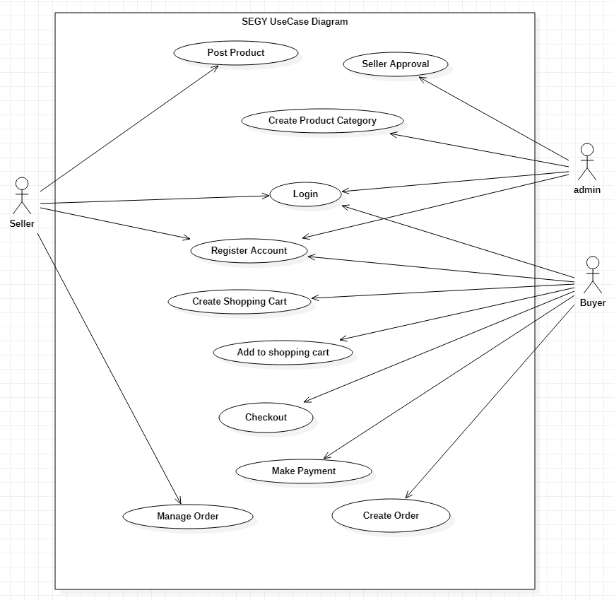
Use Case Diagram

Slide 5
Use Case lists
Login
Admin (CRUD)
Seller(CRUD)
Buyer(CRUD)
Product Category (CRUD)
Product (CRUD)
Creating Shopping Cart
Collecting Items to Cart
Payment (simulation)
Creating Order
Update Order
Generating Reciept
View Order

Slide 6
Class Diagram
Click here

Slide 7
E-R Diagram
Click to E-R

Slide 8
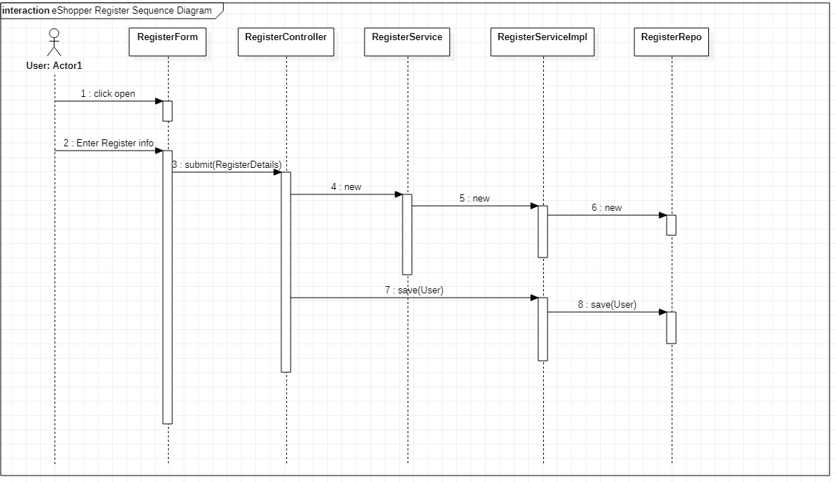
Sequence Diagram
Click to Sequence diagram

Slide 9

Thank you!

Slide 10
Demo
Click to demo

